Slide 1
PRE SHOW

Slide 2
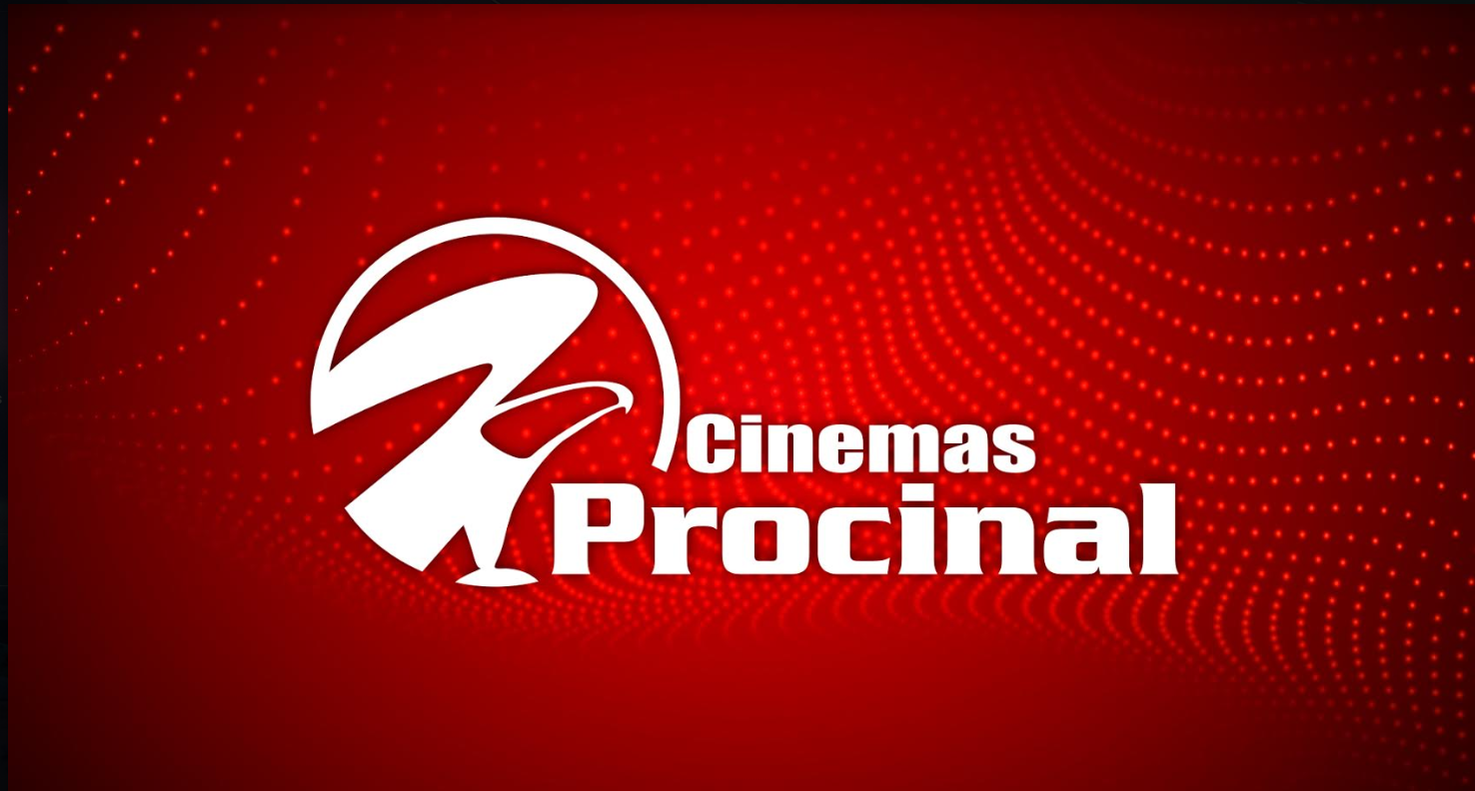

Slide 5
