Slide 1
Uniformes

Slide 2
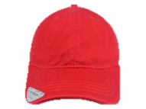
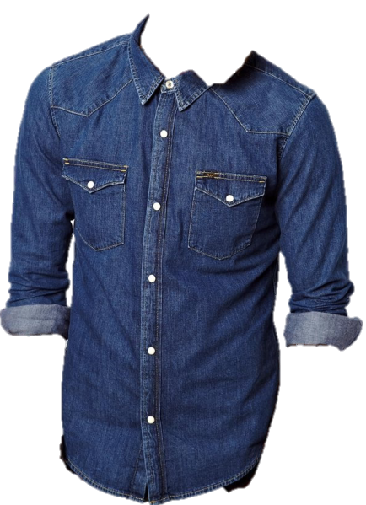
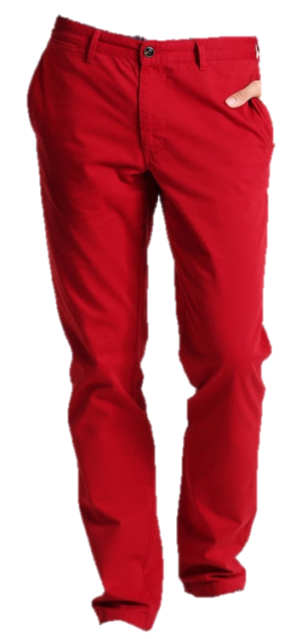
Operario
.
PERSONAL OPERATIVO
MUJER
UNIDADES | TALLA CAMISA | TALLA PANTALON | TALLA ZAPATOS
191 | S
191 | M
74 | L
30 | XL
14 | XS
49 |  | 6
164 |  | 8
109 |  | 10
76 |  | 12
85 |  | 14
21 |  | 16
16 |  |  | 34
63 |  |  | 35
139 |  |  | 36
109 |  |  | 37
90 |  |  | 38
44 |  |  | 39
28 |  |  | 40
3 |  |  | 41
HOMBRES
UNIDADES | TALLA CAMISA | TALLA PANTALON | TALLA ZAPATOS
73 | S
164 | M
71 | L
34 | XL
0 | XS
3 |  | 24
42 |  | 28
116 |  | 30
113 |  | 32
42 |  | 34
17 |  | 36
9 |  | 38
3 |  | 40
18 |  |  | 37
26 |  |  | 38
47 |  |  | 39
103 |  |  | 40
74 |  |  | 41
32 |  |  | 42
12 |  |  | 43
Gorras Rojas 800

Slide 3
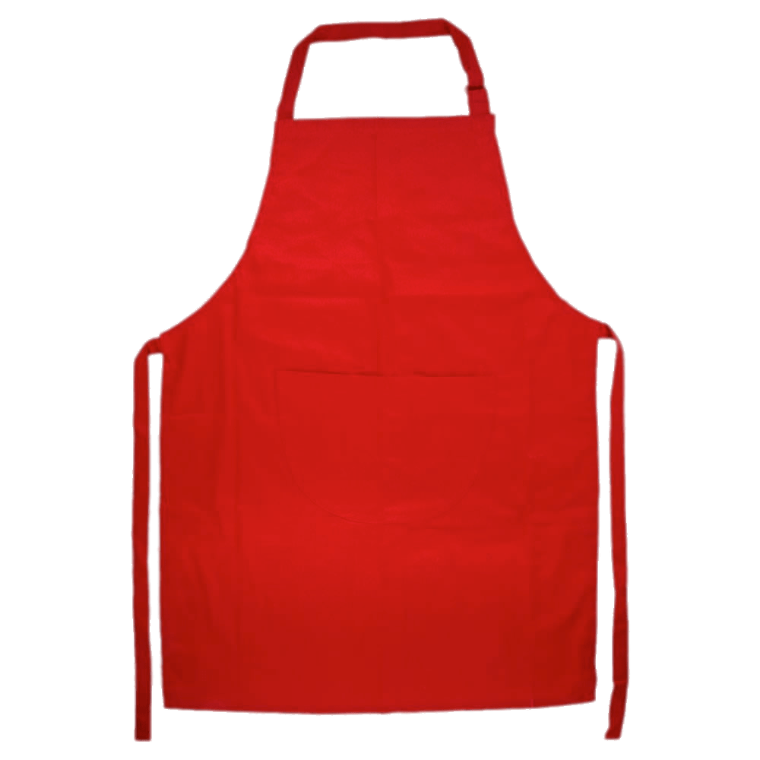
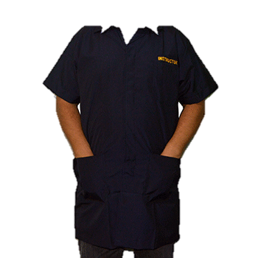
Delantales
.
300 delantales
30 batas
mantenimiento

Slide 4
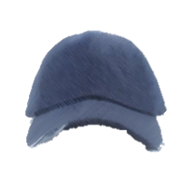
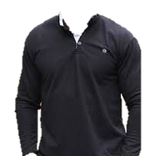
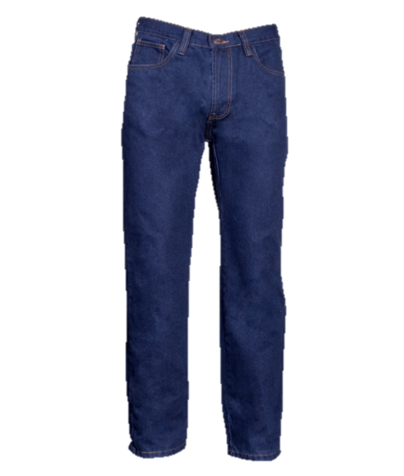
Mantenimiento
.
Gorra negra
MUJER
UNIDADES | TALLA CAMISA | TALLA PANTALON | TALLA ZAPATOS
 | S
2 | M
2 | L
 | XL
 |  | 8
2 |  | 10
 |  | 12
 |  | 14
2 |  | 16
 |  |  | 35
2 |  |  | 36
 |  |  | 37
2 |  |  | 38
 |  |  | 39
HOMBRE
UNIDADES | TALLA CAMISA | TALLA PANTALON | TALLA ZAPATOS
15 | S
31 | M
5 | L
14 | XL
3 | XXL
6 |  | 28
16 |  | 30
20 |  | 32
10 |  | 34
8 |  | 36
2 |  | 38
2 |  | 40
8 |  |  | 38
16 |  |  | 39
14 |  |  | 40
8 |  |  | 41
16 |  |  | 42
6 |  |  | 43
Camisa tipo polo manga larga negra
Jean Azul
GORRAS NEGRAS 120

